Slide 1

Ensemble Task
Isidora Jankov
External collaborators:
NOAA Environmental Modeling Center
NCAR Mesoscale and Microscale Meteorology Division
Notes:
Add something on MMET

Slide 2
Team Members, Collaborators and Acknowledgements
Team Members
Jamie Wolf–NCAR
Jeff Beck–GSD
James Frimell-GSD
Hongli Jiang–GSD
Zoltan Toth–GSD
Isidora Jankov-GSD
Collaborators
Judith Berner-NCAR
Georg Grell - GSD
Jacques Midlecoff–GSD
Vladimir Krasnopolsky–EMC
Dan Fiorino– CU
Acknowledgments
Ligia Bernardet–GSD
Laurie Carson–NCAR
Tom Black–EMC
Brad Ferrier-EMC
Istvan Geresdi–University of Pecs
DTC Visitor Program
Paul Roebber-University
of Wisconsin

Slide 3
DTC Ensemble Task Work in AOP 2015
2015
Budget: 440k
Distribution: ~2 FTE between GSD and NCAR
Tasks:
EN1: NARRE repository maintenance and Rocoto end-to-end workflow
EN2: Testing of stochastic physics for use in NARRE
Carry over from 2014
Budget: ~150k
Distribution: ~0.7 FTE at GSD
Tasks:
EN6a: Testing of a Neural Network emulator of the Thompson microphysics in NMMB

Slide 4
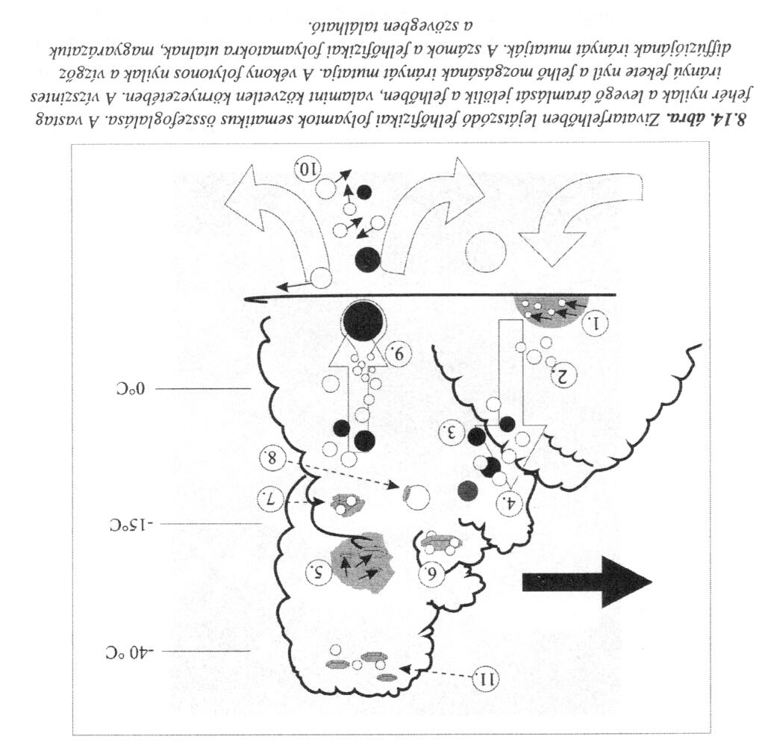
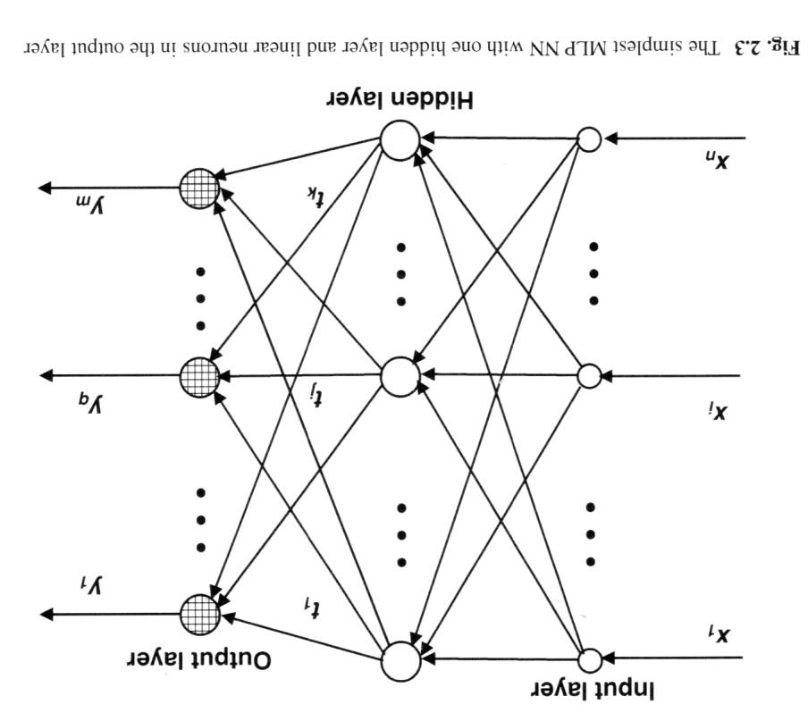
Carry – over 2014 activities
EN6a: Testing of a Neural Network emulator of the Thompson microphysics in NMMB

Slide 5
Motivation
ESRL seminar by Dr. Yougnsun Jung on MP, 2013
Multitude of 2-moment MP schemes, each
  Expensive
  Complex
  Capture only part of reality
Use Neural Networks to
  Speed schemes up
  Combine positive aspects of physically based schemes?
  Inject stochastic element needed for use with ensembles
Project Plan
Develop & test NN emulator of Thompson MP in NMMB
Generate training sample for NN development
Training and off-line testing of NN-MP within NMMB
Evaluate nonlinear forecasts with NN-MP
Report on
  Quality
  Computational efficiency
  Possible next steps

Slide 6
Progress Report
Slow start
  Multiple staff changes due to reorganization, retirement
  NMMB model new to GSD – learning curve
Completed
  Detailed plan, experimental design
  NMMB code modification to write out MP variables
  NMMB script to run forecasts
  Output files validated at GSD & EMC
Ongoing
  Transfer from Zeus to Theia
  Ingest training data into NN
  Prepare NMMB evaluation & verification routines
Remaining steps
  Generate training sample data for 16 cases
  Train and test off-line the NN-MP
  Insert NN-MP into NNMB
  Run 1-2 NNMB test forecasts with NN-MP
  Evaluate & compare meteorological & computational performance of NMMB w Thompson vs NN MP (& Ferrier?) schemes
  Prepare report

Slide 7
Potential Future Extension
Combine good aspects of various MP schemes in NN (not only T-MP)
  For each case, train with scheme performing best
  Improved performance
Stochastic version of NN-MP
  For ensemble applications
Use NN-MP in analysis of MP & related variables as a constraint
Develop NN-MP for a bin MP scheme
  Operationally feasible?
Use advanced observations in NN-MP training?
  Beyond forecast data, consider Dual Pol Radar, etc

Slide 8
2015 Activities
EN1: NARRE repository maintenance and Rocoto end-to-end workflow
EN2: Testing of stochastic physics for use in NARRE

Slide 9
SVN Centralized Collaboration Environment
Initial software and support environment modeled from the successful HWRF approach.
NARRE SVN Repository https://svn-dtc-narre.cgd.ucar.edu
NARRE WIKI https://wiki,ucar.edu/display/DTC/NARRE
DTC
NARRE
Software Repository
DTC – Software Repositories
GSI
WPS
NPS
WRF
NEMS
UPP
EMC – snapshot
SREFPP
EMC
Operational Packages
Community Development

Slide 10
NARRE Data Flow
Ensemble products
GSI
WPS
WRF
UPP
SREFPP
RAP
4-members
GSI
NPS
NAMRR
UPP
NAM RR
4-members
Verification
products
MET
RAP workflow ported to Zeus. Theia and Jet, needs to be tested on Yellowstone
NAMRR cycling tested
SREFPP needs to be added to rocoto workflow
SREFPP needs to be tested with all 8 members
MET/MODE will be added next

Slide 11
EN2: Testing of stochastic physics for use in NARRE
Experiment Design
Regional RAP model simulations
14 day period 15-31 May, 2013, 24 hr simulations
12Z initialization
Focus on convective Grell-Freitas parameterization
Simulated precipitations evaluated against Stage IV data
Other standard variables (tmp., height, wind) against NDAS analysis
Precipitation verification using MET (statistics options and precipitation thresholds somewhat limited, learning how to use metviewer)
The rest of the verification was performed using EMC code
Verifications performed over CONUS

Slide 12
Experiments
Mixed Physics Ensemble includes Kain Fritsch (KF), SAS scheme, Betts-Miller-Janjic (BMJ) and Grell Freitas (GF) convective parameterizations – ctrl
The latest version of WRF-ARW an option for generation of a field of random perturbations with user specifying random perturbation length-scale, temporal de-correlation (Judith Berner)
Stochastically perturbed parameter ensemble experiments:
  Stochastically perturbed closures-V3
  In addition to the closure perturbations entrainment rate was perturbed – V3_exp
  In addition to the closure perturbations max capping inversion was perturbed–V3_exp3
  SKEBS scheme was added to closure perturbations – V3_skeb
V3 outperformed V3_exp and V3_exp3
Effects that combination of stochastic parameter perturbation and SKEBS has on the results

Slide 13
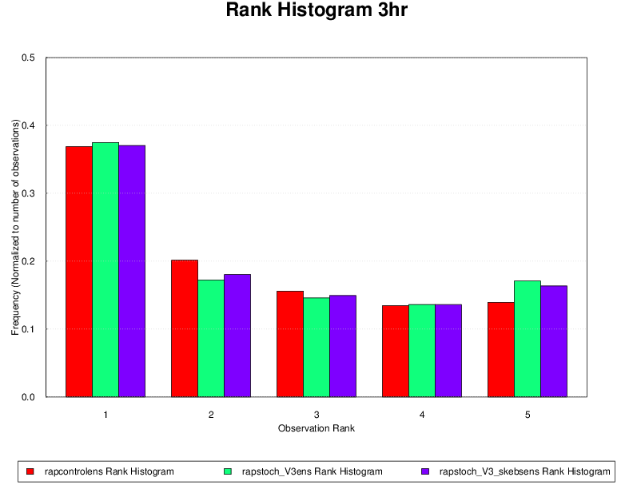
Rank Histogram- 3hry precip.

Slide 14
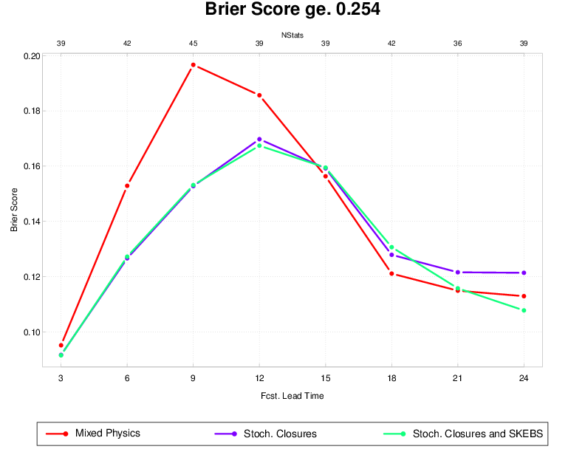
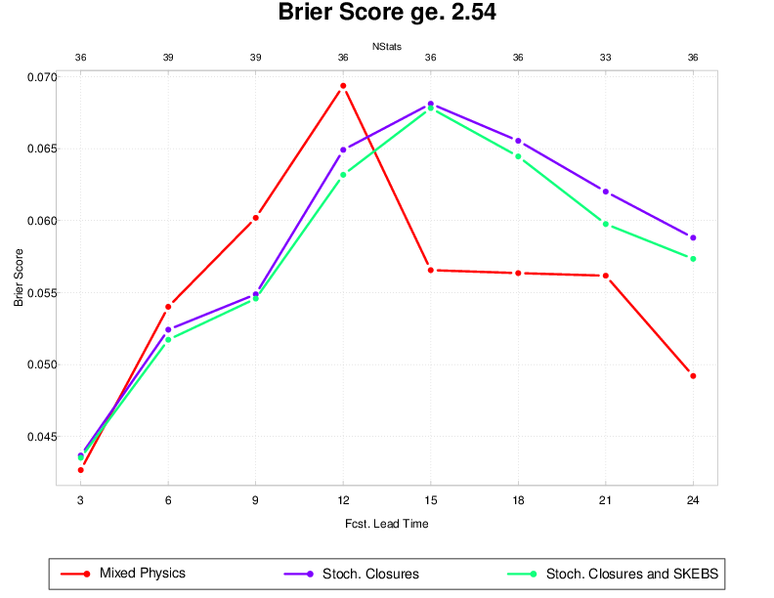
Precipitation Analysis
3hrly accumulations, thresholds in mm

Slide 15
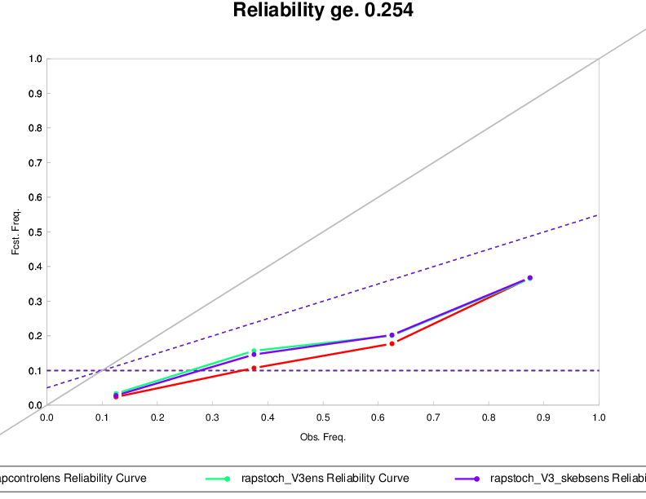
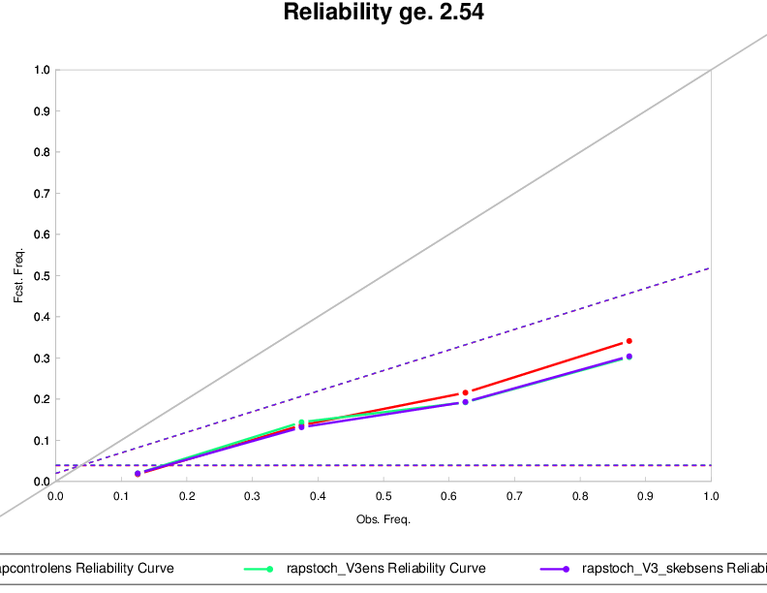
Reliability Diagram
(3hrly accumulations)

Slide 16
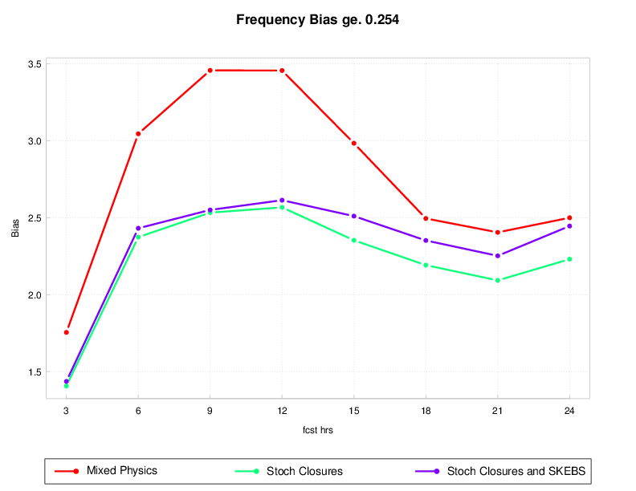
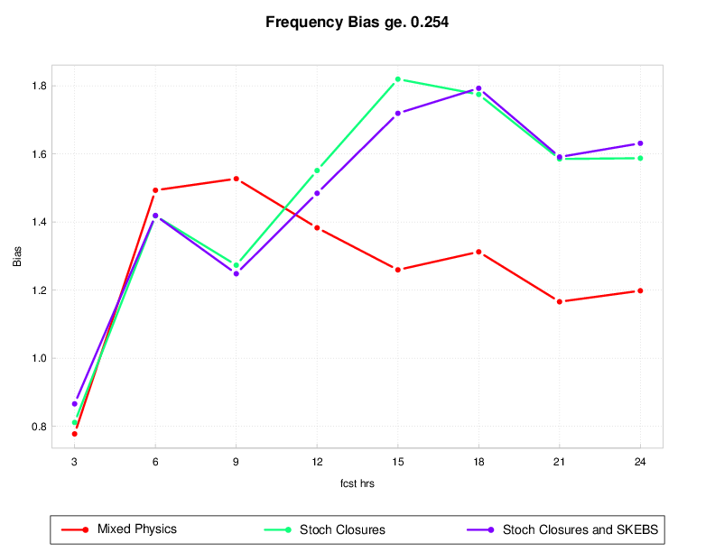
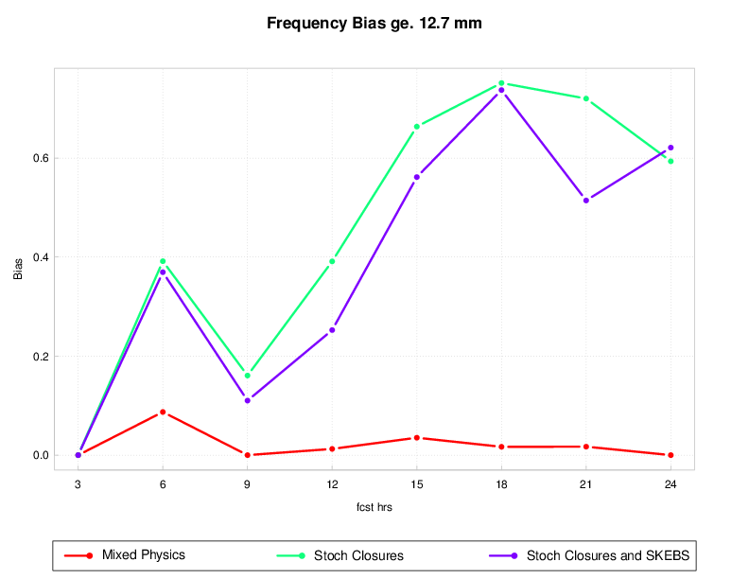
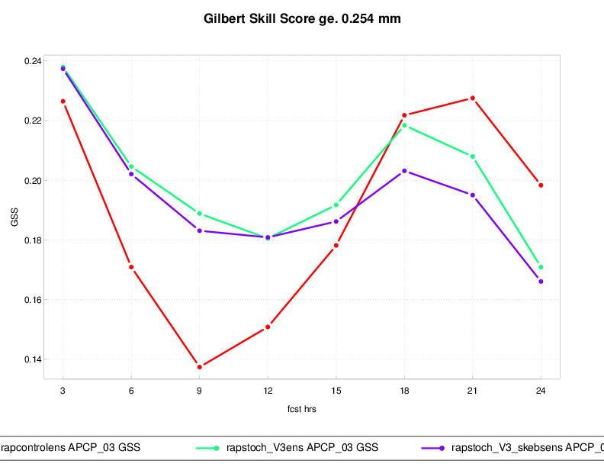
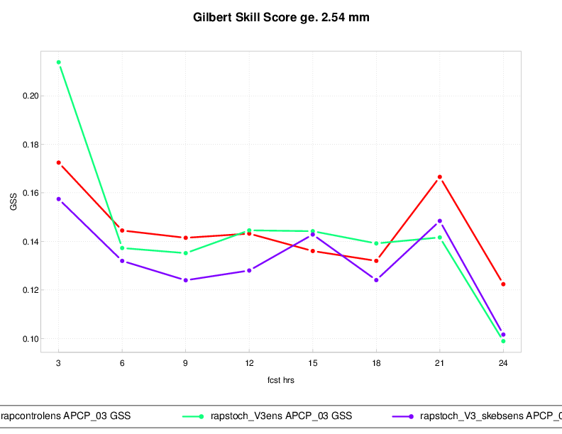
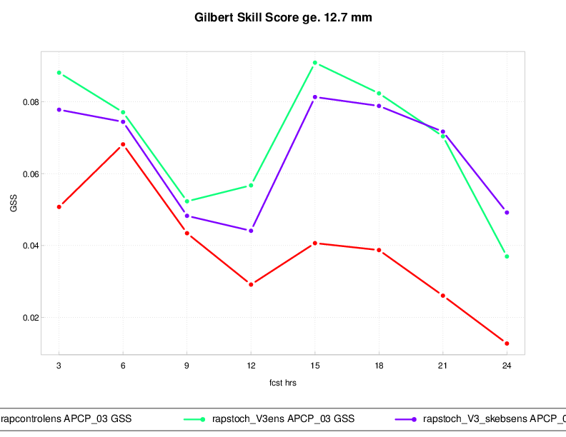
Ensemble mean Bias and GSS

Slide 19
Summary
Stochastic perturbation of closures alone performed better than when perturbation in entrainment rate and max. capping inversion were added
Precipitation evaluation showed generally comparable performance between different approaches (some advantage of stochastic approach for very low and higher precip. thresholds was observed)
Evaluation of standard variables showed a value added by combining stochastic perturbation with SKEBS
New version of GF scheme will be tested next
Additional ensemble diagnostics will be evaluated (thanks to Walter K.)
Preparing code to perform similar tests using LSM (and or PBL)

Slide 20
Extension of existing and potential new activities for AOP 2016
Suggestions were made having in mind outcomes from the Storm-Scale Ensemble Design Workshop, that recently took place in Boulder.
EN1:
Enhance NARRE scripts to include a component of regional ensemble DA
Enhance scripts with additional ensemble diagnostics
Add spatial and object based verification
Additional suggestions????
EN2:
Further test stochastic physics within ARW to improve parameter specification to achieve effective spread and overall improved results
Test stochastic physics within 3km/HRRR environment for initial test of its effectiveness at those scales
Work with DA3 on use of stochastic physics for ensemble data assimilation
Additional suggestions???

Slide 21
Potential new activities in AOP 2016???

Slide 22
Additional Material

Slide 23
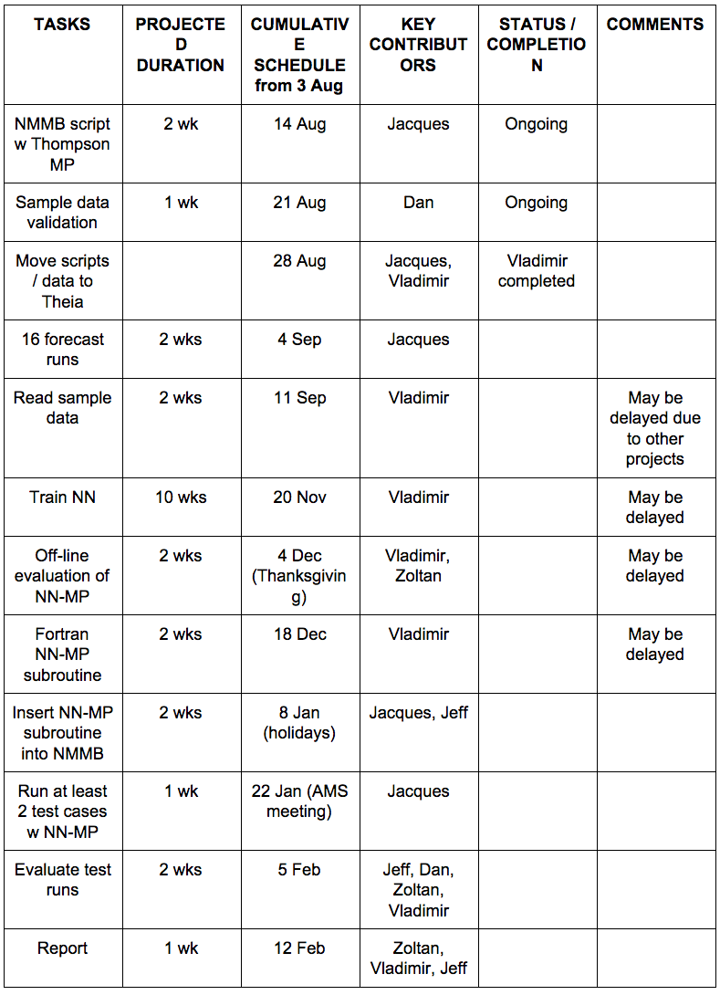
PROJECTED
SCHEDULE

Slide 24
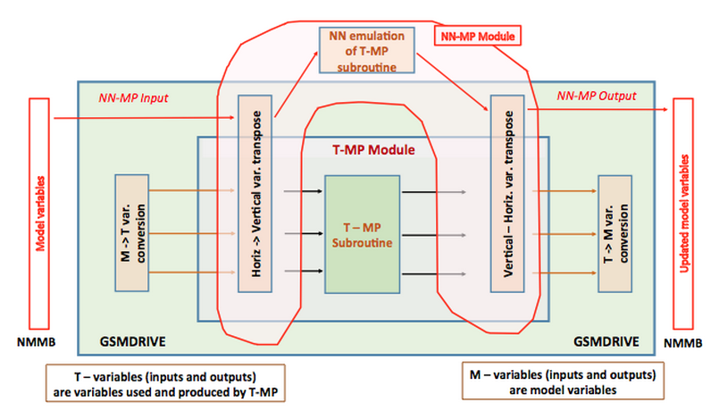
OVERALL DESIGN OF NN-MP IN NNMB

Slide 25
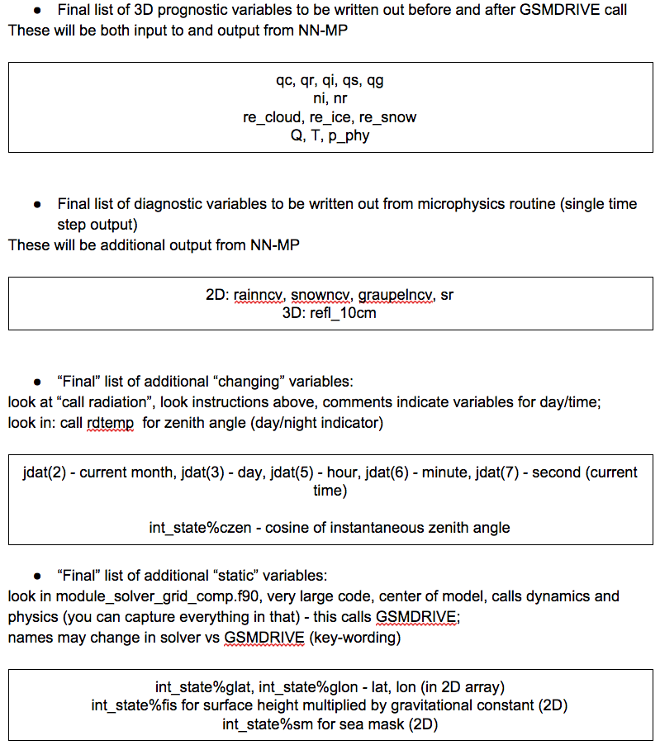
LIST OF OUTPUT VARIABLES

Slide 26
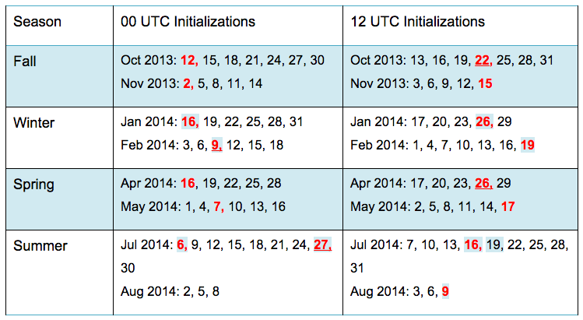
LIST OF SELECTED FORECAST DATES
Subset of dates in Jamie’s test protocol

Slide 27
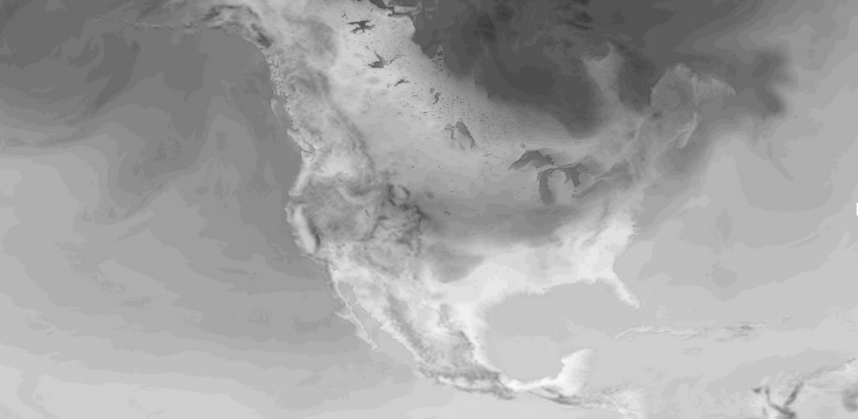
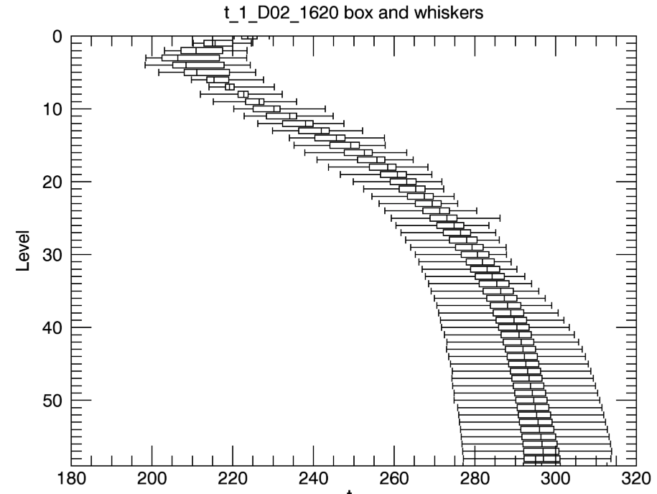
VALIDATION OF DATA

