Slide 1
Assessment of two microphysics schemes in the NOAA Environmental Modeling System (NEMS) Non-hydrostatic Multiscale Model on the B-grid (NMMB)
Jamie Wolff
Jeff Beck, Laurie Carson, Michelle Harrold, Tracy Hertneky
15 April 2015

Slide 2
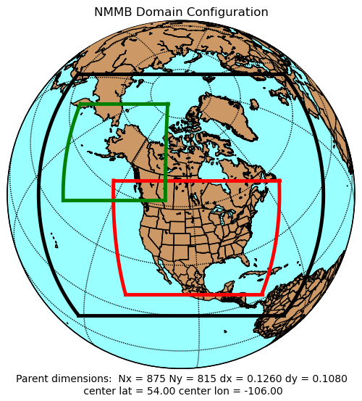
NEMS-NMMB Inter-comparison Testing and Evaluation (T&E)
End-to-end system: NPS, NMMB, UPP, and MET
Test period: One month per season, w/ 48-h forecasts initialized every 36 h (total of 94 cases)
Domain: 12-km North American grid, 3-km CONUS and AK nests
Evaluation:
Surface and upper air [BCRMSE, bias] –
temperature, dew point, wind speed
Precipitation [Gilbert skill score (GSS), frequency bias] –
3- and 24-h accumulations, composite reflectivity
Statistical Assessment
Confidence Intervals (CI) at the 99% level
Pair-wise difference methodology
Statistical Significance (SS) and practical significance (PS)
Verification by observation station – temperature, dew point temperature, and wind speed bias
Accumulated stats over domain – base rate, GSS, frequency bias
Accumulated model output over domain – PBL height, SW/LW radiation, sensible/latent heat flux
Fall | 12 Oct – 15 Nov 2013
Winter | 16 Jan – 19 Feb 2014
Spring | 16 Apr – 17 May 2014
Summer | 6 Jul – 9 Aug 2014

Slide 3
NEMS-NMMB Inter-comparison T&E
Initial conditions: Parallel NAM (NAMX) which used the global ensemble Kalman filter (EnKF) in the regional North American Data Assimilation System (NDAS)
Physics suite:
Evaluation: Performance assessment of the Ferrier-Aligo and Thompson microphysics schemes
 | Current NAM Op Configuration | Replacement Configuration
Microphysics | Ferrier-Aligo | Thompson
Radiation SW and LW | RRTM | RRTM
Surface Layer | MYJ | MYJ
Land-Surface Model | Noah | Noah
Planetary Boundary Layer | MYJ | MYJ
Convection | BMJ (parent only) | BMJ (parent only)

Slide 4
Inter-comparison results
NAM Operational Configuration (NAMOC)
Thompson Replacement Configuration (ThompsonMP)

Slide 5
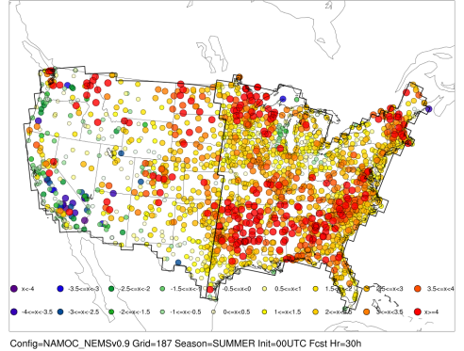
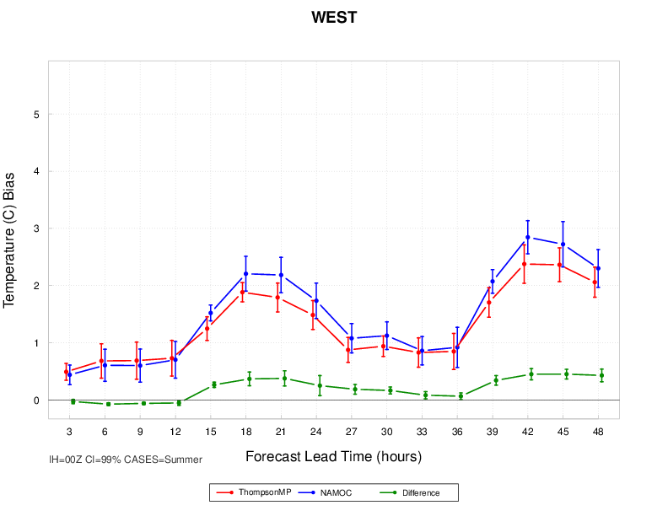
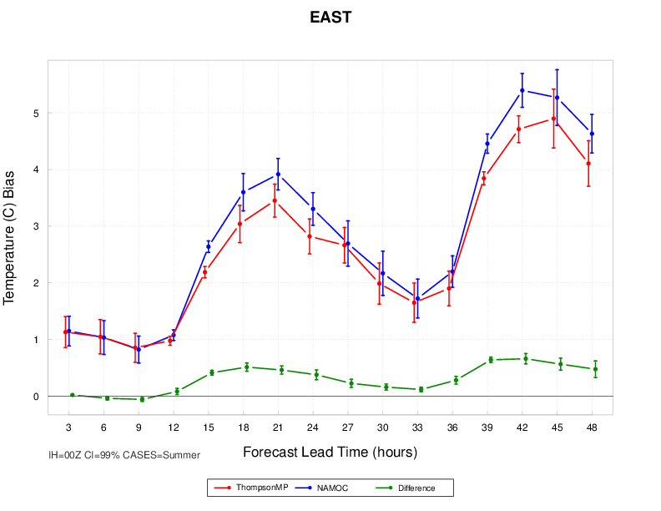
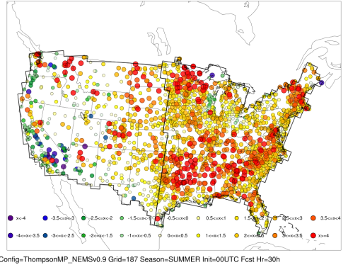
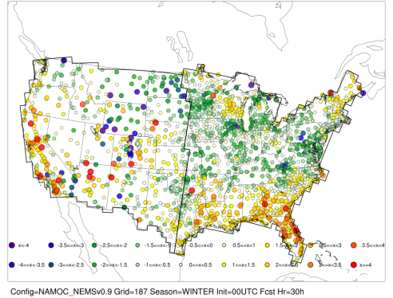
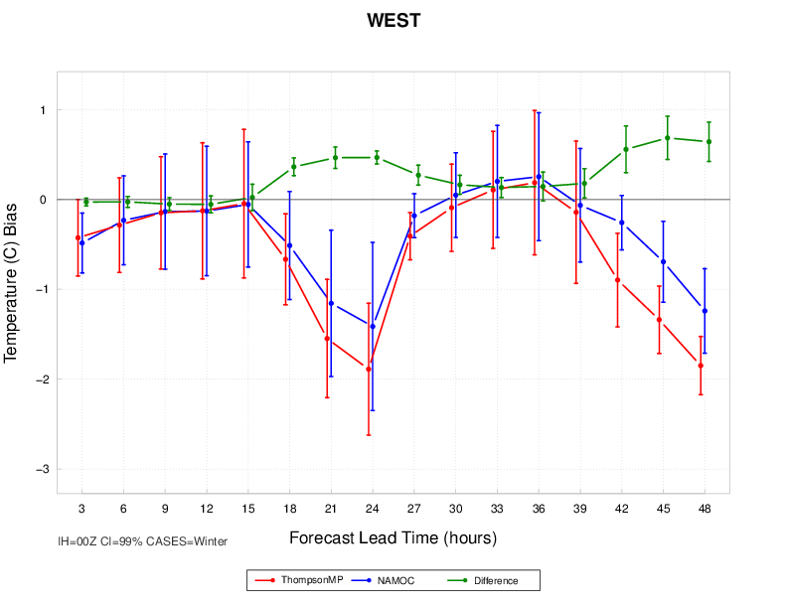
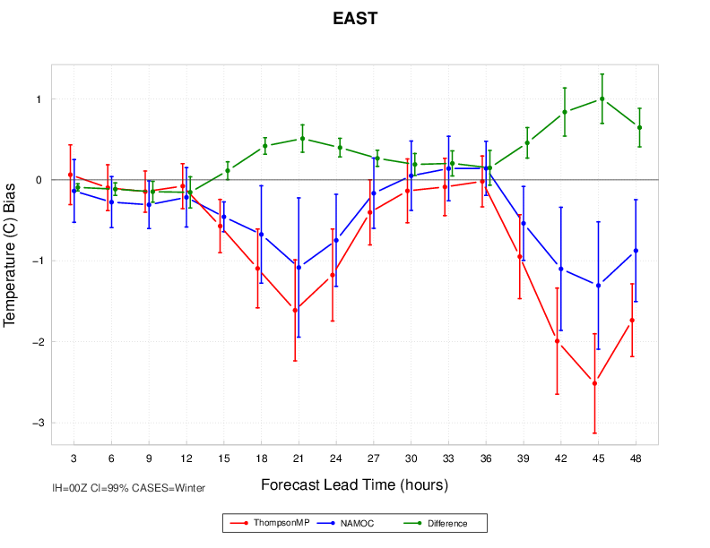
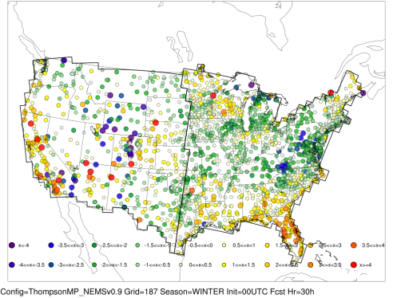
2-m Temperature Bias 00 UTC initializations - Fcst Hr 30
NAMOC
Summer
ThompsonMP
NAMOC ThompsonMP Difference
NAMOC
Winter
ThompsonMP

Slide 6
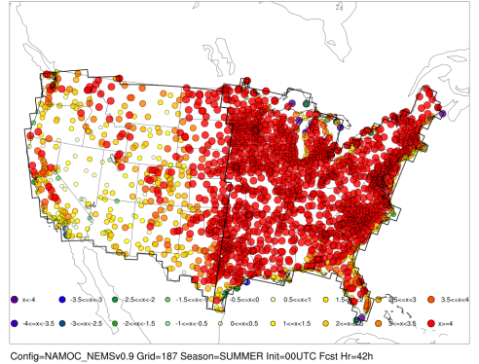
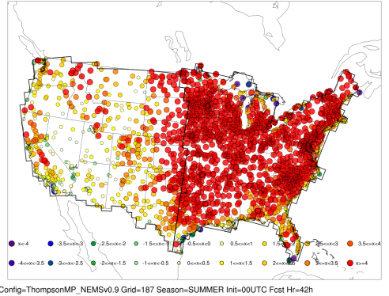
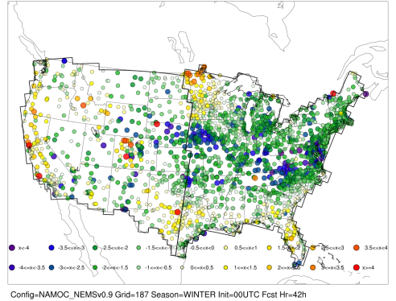
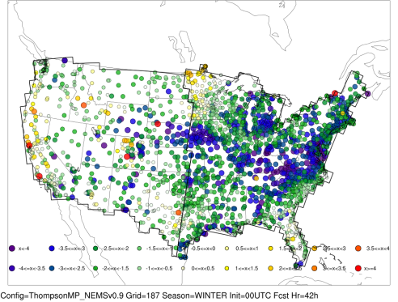
2-m Temperature Bias 00 UTC initializations - Fcst Hr 42
NAMOC
Summer
ThompsonMP
NAMOC ThompsonMP Difference
NAMOC
Winter
ThompsonMP

Slide 7
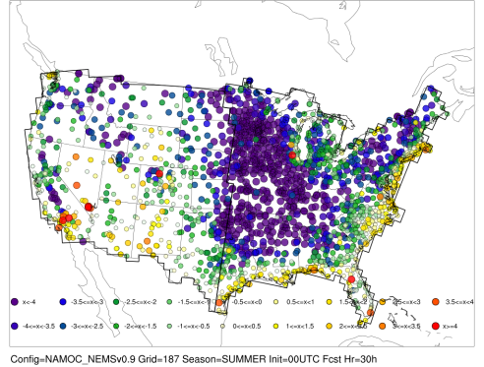
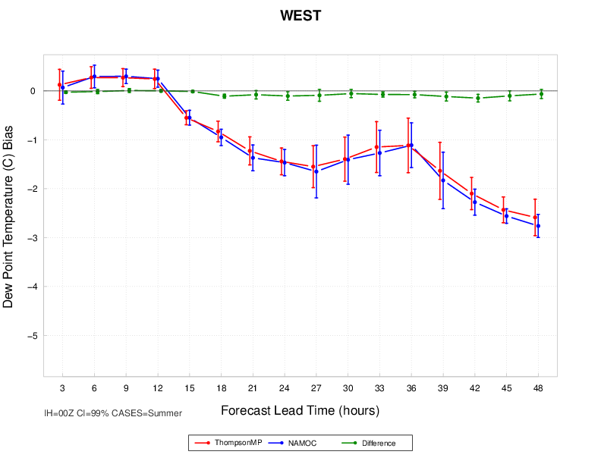
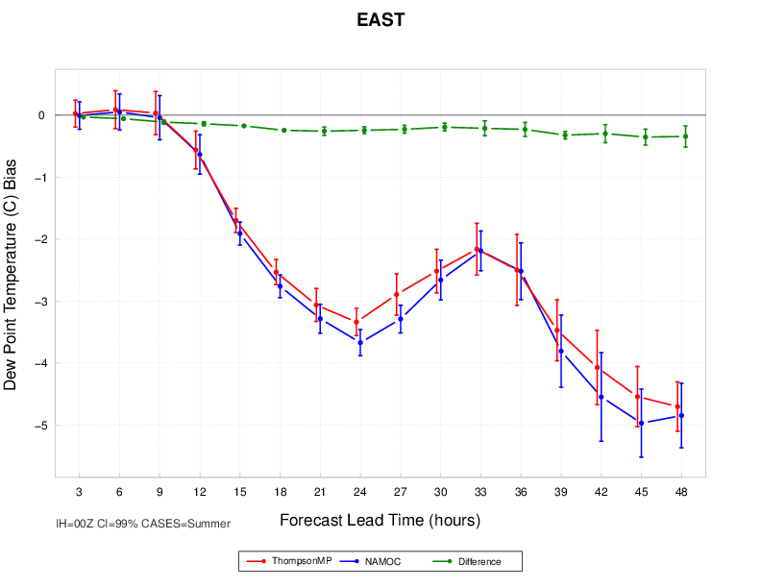
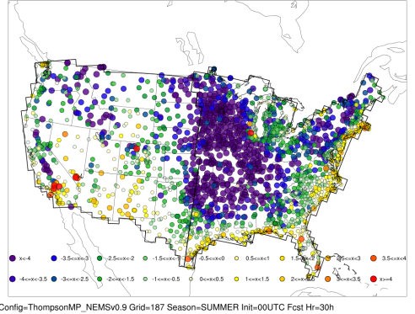
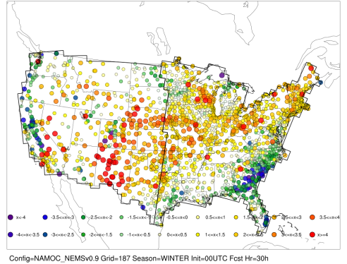
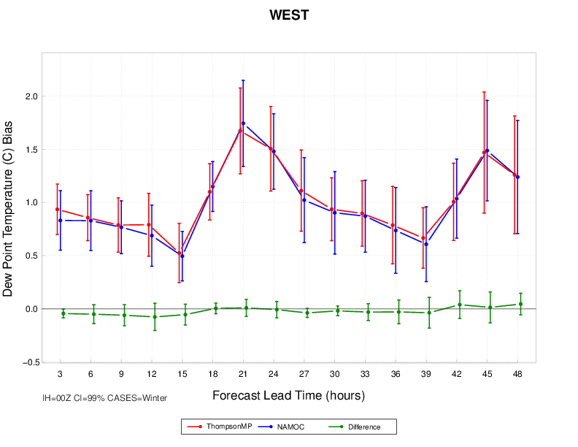
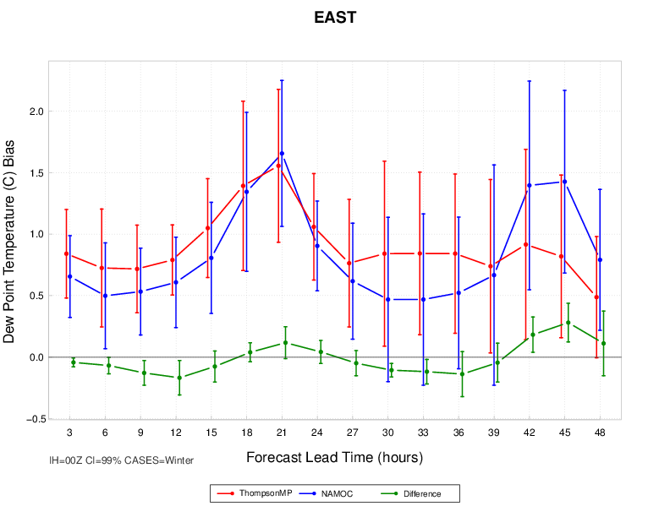
2-m Dew Point Bias 00 UTC initializations - Fcst Hr 30
NAMOC
Summer
ThompsonMP
NAMOC ThompsonMP Difference
NAMOC
Winter
ThompsonMP

Slide 8
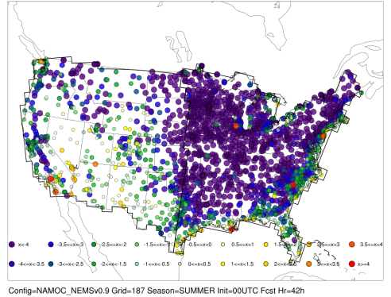
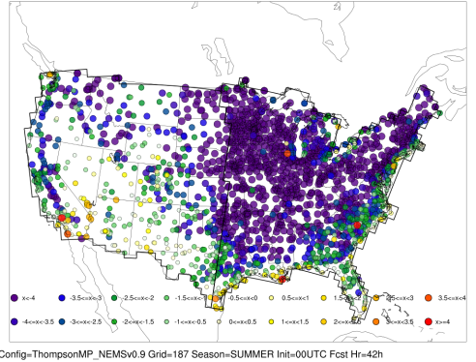
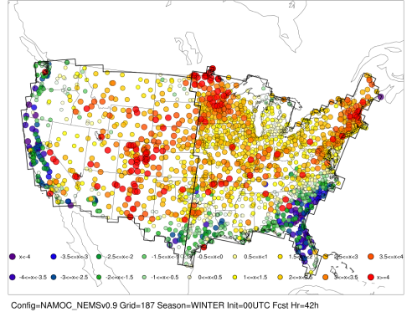
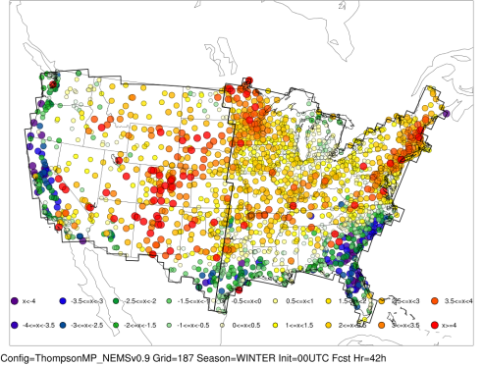
2-m Dew Point Bias 00 UTC initializations - Fcst Hr 42
NAMOC
Summer
ThompsonMP
NAMOC ThompsonMP Difference
NAMOC
Winter
ThompsonMP

Slide 9
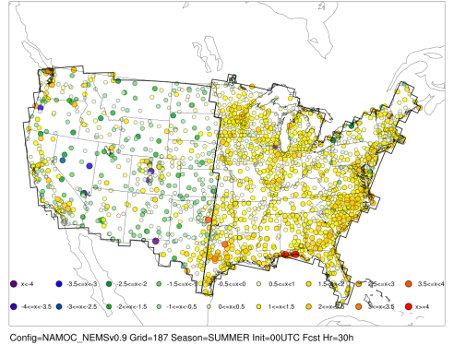
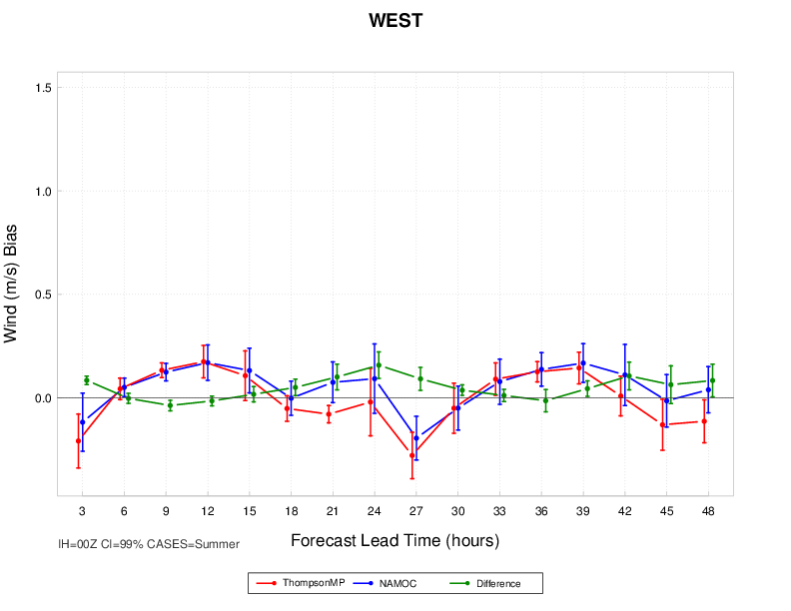
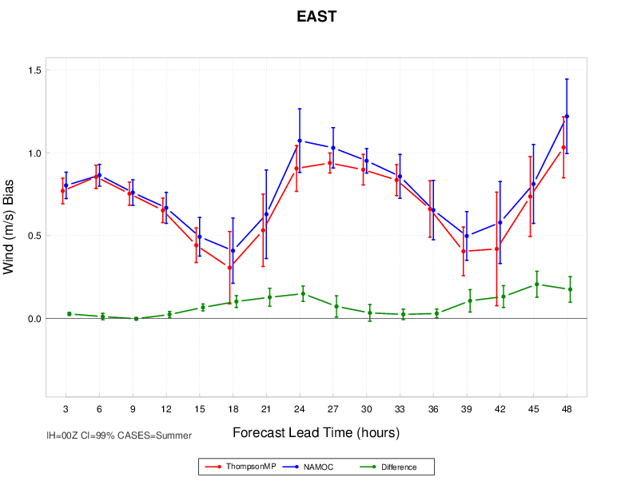
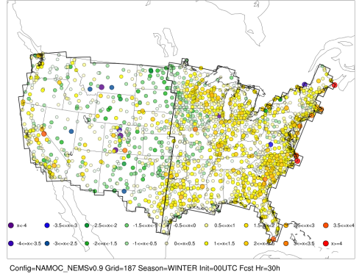
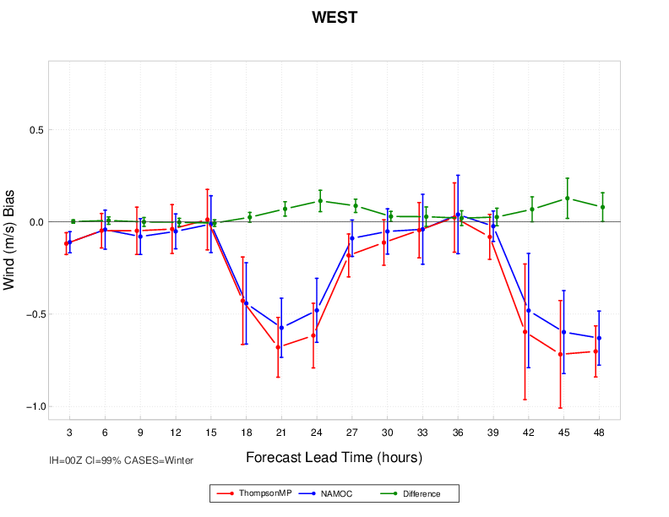
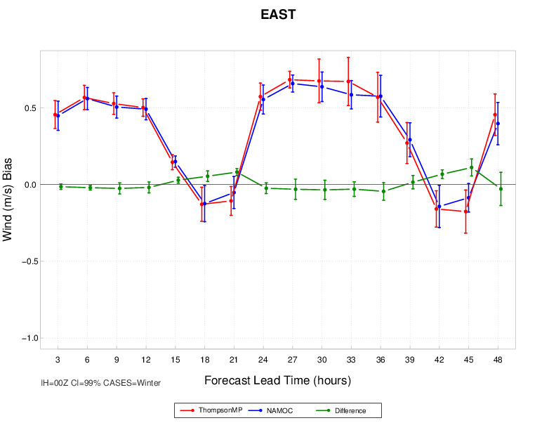
10-m Wind Speed Bias 00 UTC initializations - Fcst Hr 30
NAMOC
Summer
ThompsonMP
NAMOC ThompsonMP Difference
NAMOC
Winter
ThompsonMP

Slide 10
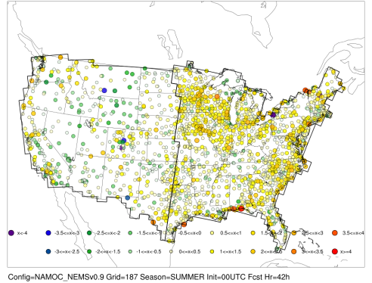
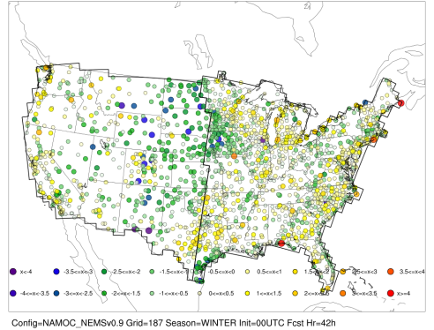
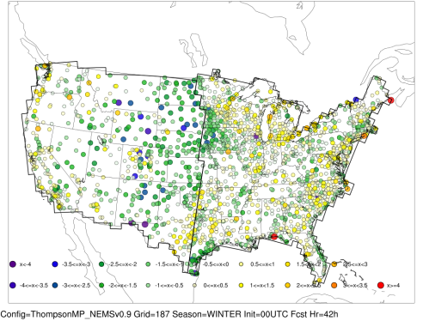
10-m Wind Speed Bias 00 UTC initializations - Fcst Hr 42
NAMOC
Summer
ThompsonMP
NAMOC ThompsonMP Difference
NAMOC
Winter
ThompsonMP

Slide 11
Surface Bias – SS/PS Differences 00 UTC Initializations
2 m Temperature
2 m Dew Point Temperature
10 m Wind Speed
48%
50%
45%
38%
34%
30%
25%
14%
16%
SS (light shading) & PS (dark shading) differences for surface temp, dew point, & wind speed bias
NAMOC better performer ThompsonMP better performer
 |  |  |  | f03 | f06 | f09 | f12 | f15 | f18 | f21 | f24 | f27 | f30 | f33 | f36 | f39 | f42 | f45 | f48
 | 2-m Temperature | Summer | East | ThompMP | NAMOC | NAMOC | ThompMP * | ThompMP * | ThompMP * | ThompMP * | ThompMP * | ThompMP * | ThompMP * | ThompMP * | ThompMP * | ThompMP * | ThompMP * | ThompMP * | ThompMP *
 |  |  | West | -- | NAMOC | NAMOC | NAMOC | ThompMP * | ThompMP * | ThompMP * | ThompMP * | ThompMP * | ThompMP * | ThompMP * | ThompMP * | ThompMP * | ThompMP * | ThompMP * | ThompMP *
 |  | Winter | East | ThompMP * | ThompMP * | ThompMP * | -- | NAMOC * | NAMOC * | NAMOC * | NAMOC * | NAMOC * | NAMOC * | ThompMP * | -- | NAMOC * | NAMOC * | NAMOC * | NAMOC *
 |  |  | West | -- | -- | -- | -- | -- | NAMOC * | NAMOC * | NAMOC * | NAMOC * | NAMOC * | ThompMP * | -- | NAMOC * | NAMOC * | NAMOC * | NAMOC *
 | 2-m Dew Point | Summer | East | NAMOC | NAMOC | ThompMP * | ThompMP * | ThompMP * | ThompMP * | ThompMP * | ThompMP * | ThompMP * | ThompMP * | ThompMP * | ThompMP * | ThompMP * | ThompMP * | ThompMP * | ThompMP *
 |  |  | West | NAMOC | -- | -- | -- | -- | ThompMP * | -- | ThompMP * | -- | -- | ThompMP * | ThompMP * | ThompMP * | ThompMP * | -- | --
 |  | Winter | East | NAMOC | NAMOC * | NAMOC * | NAMOC * | -- | -- | -- | -- | -- | NAMOC * | NAMOC * | -- | -- | ThompMP * | ThompMP * | --
 |  |  | West | NAMOC | -- | -- | -- | -- | -- | -- | -- | -- | -- | -- | -- | -- | -- | -- | --
 | 10-m Wind Speed | Summer | East | ThompMP | -- | -- | ThompMP | ThompMP | ThompMP | ThompMP | ThompMP | ThompMP | -- | -- | ThompMP | ThompMP | ThompMP | ThompMP | ThompMP
 |  |  | West | NAMOC | -- | NAMOC | -- | -- | NAMOC | NAMOC | ThompMP | NAMOC | NAMOC | -- | -- | ThompMP | ThompMP | -- | NAMOC
 |  | Winter | East | -- | NAMOC | -- | -- | ThompMP | NAMOC | NAMOC | -- | -- | -- | -- | -- | -- | NAMOC | NAMOC | --
 |  |  | West | -- | -- | -- | -- | -- | -- | NAMOC | NAMOC | NAMOC | NAMOC | -- | -- | -- | NAMOC | NAMOC | NAMOC

Slide 12
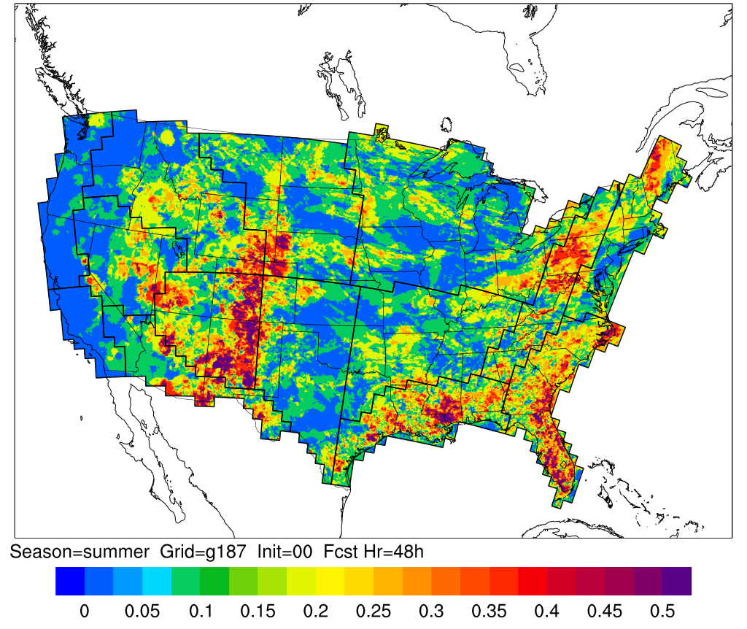
Base Rate (> 0.01”) 00 UTC Initialization – Fcst Hr 48; Summer

Slide 13
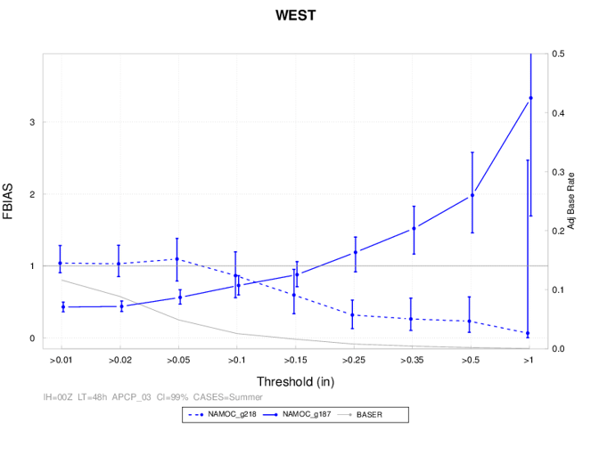
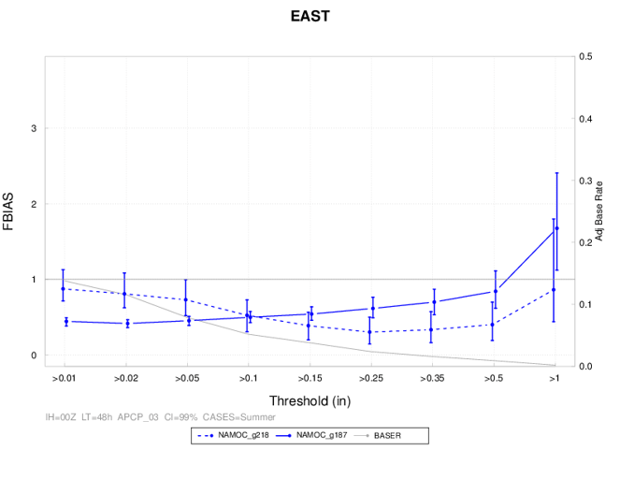
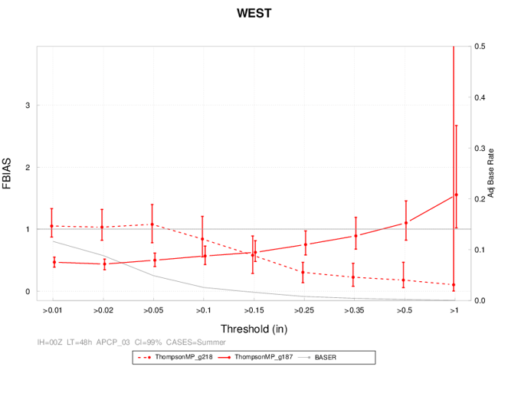
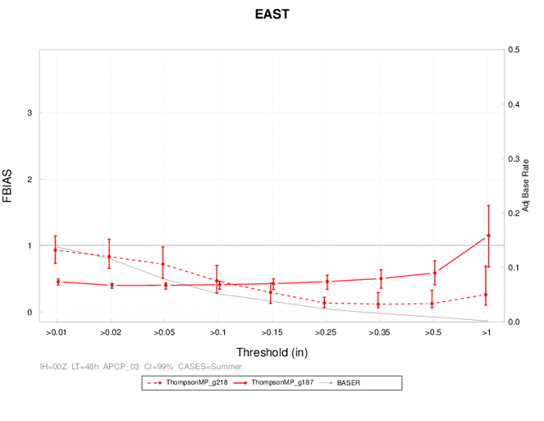
03-h Precipitation Frequency Bias 00 UTC initializations – Fcst Hr 48; Summer
NAMOC
NAMOC ThompsonMP Base Rate
Dashed: g218 (~12km) Solid: g187 (~2.5km)
ThompsonMP

Slide 14
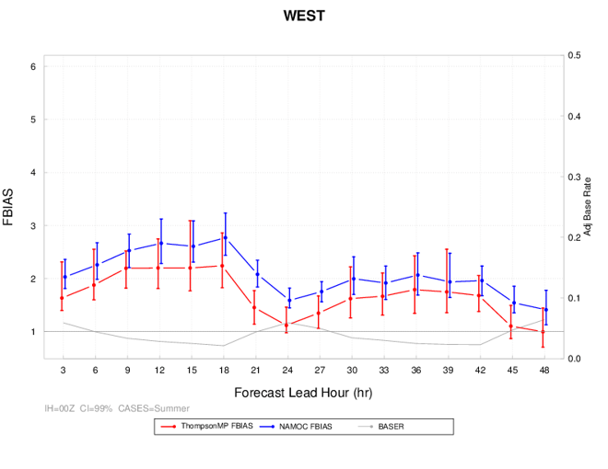
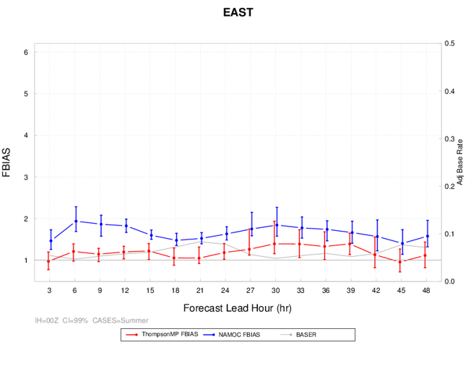
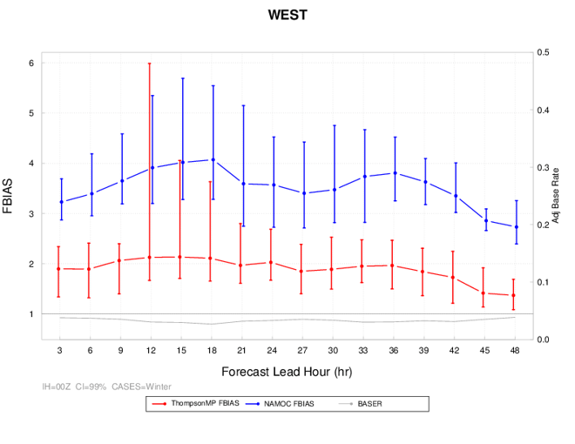
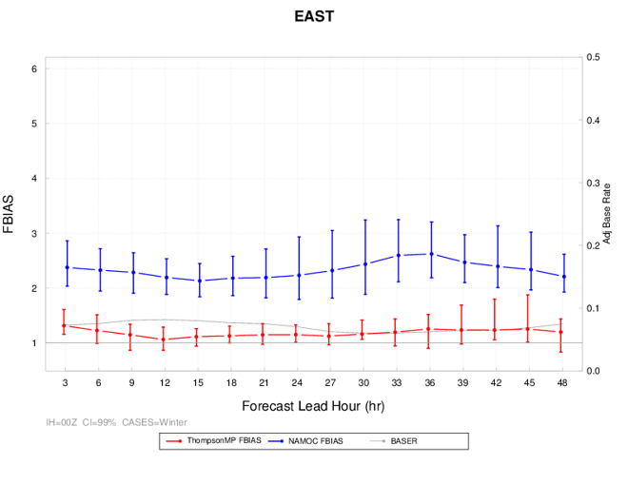
Reflectivity Frequency Bias 00 UTC initializations – Threshold ≥ 10 dBZ
Summer
NAMOC ThompsonMP Base Rate
Winter

Slide 15
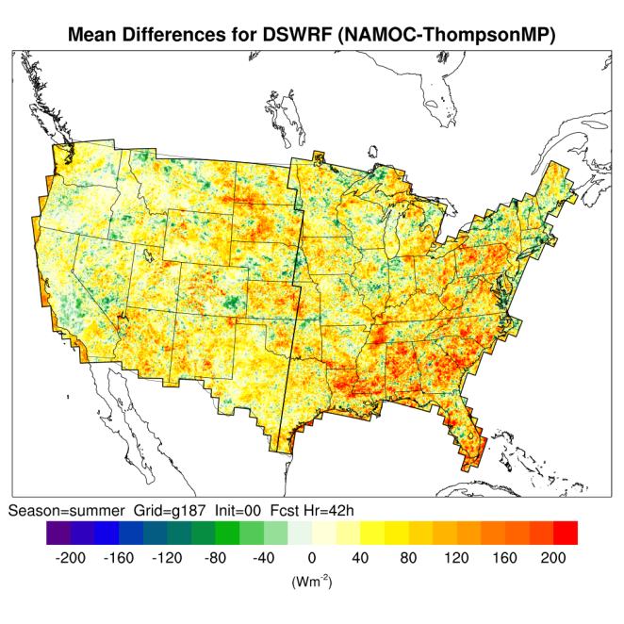
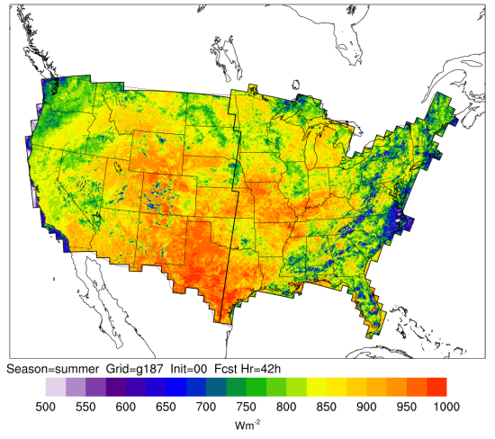
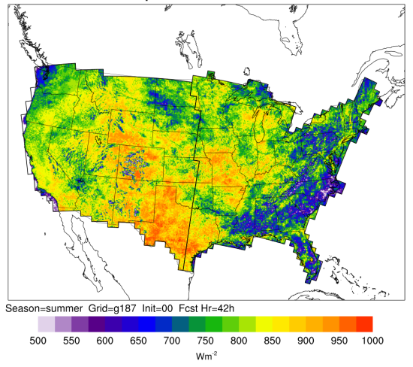
Downward Shortwave Radiation 00 UTC Initializations – Fcst Hr 42; Summer
NAMOC
ThompsonMP
NAMOC – ThompsonMP
Diff > 0 → NAMOC has larger values
Diff < 0 → ThompsonMP has larger values

Slide 16
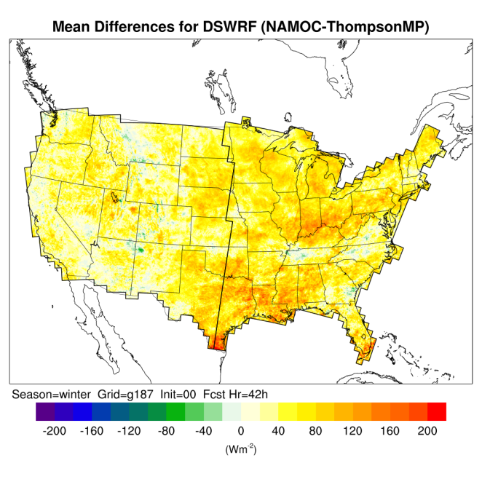
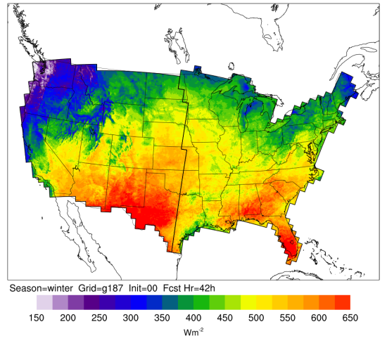
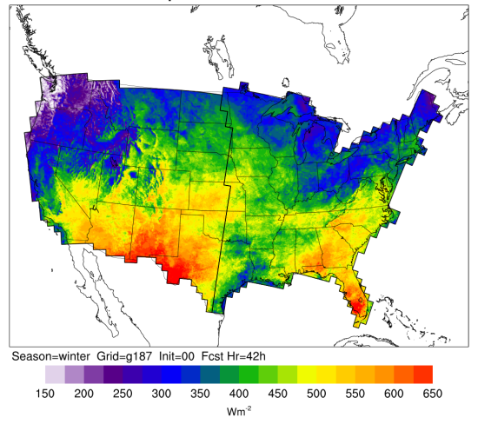
Downward Shortwave Radiation 00 UTC Initializations – Fcst Hr 42; Winter
NAMOC
ThompsonMP
NAMOC – ThompsonMP
Diff > 0 → NAMOC has larger values
Diff < 0 → ThompsonMP has larger values

Slide 17
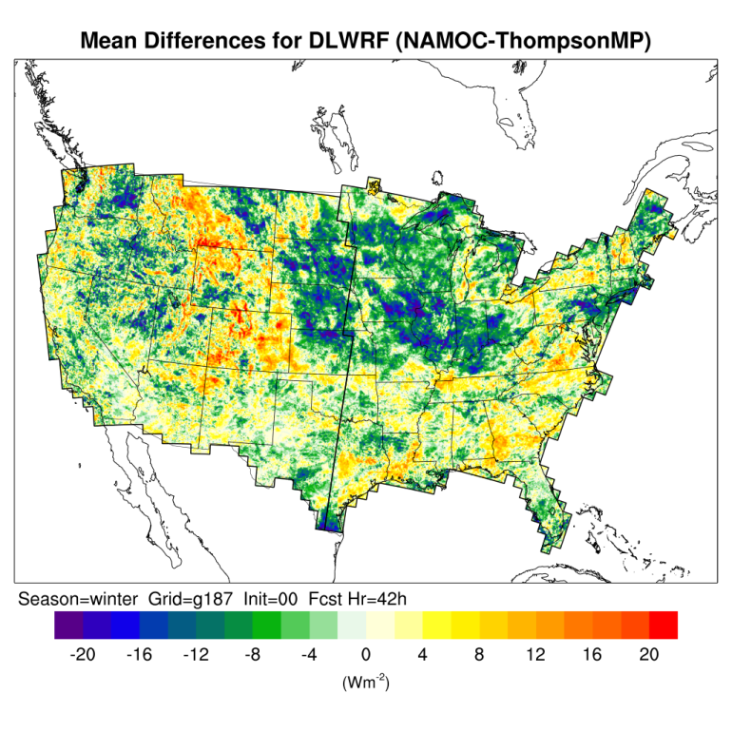
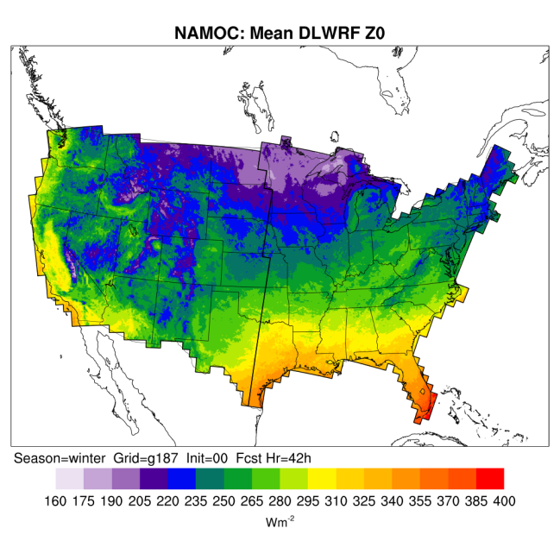
Downward Longwave Radiation 00 UTC Initializations – Fcst Hr 42; Winter
NAMOC
ThompsonMP
NAMOC – ThompsonMP
Diff > 0 → NAMOC has larger values
Diff < 0 → ThompsonMP has larger values

Slide 18
Upward Longwave Radiation 00 UTC Initializations – Fcst Hr 42; Winter
NAMOC
ThompsonMP
NAMOC – ThompsonMP
Diff > 0 → NAMOC has larger values
Diff < 0 → ThompsonMP has larger values

Slide 19
Summary
Performed extensive T&E on two NEMS-NMMB configurations
Differences seen from surface through atmosphere – focus of presentation on near-surface variables
Performance differs spatially and temporally
2 m temperature
Both configurations had warm biases in the summer and neutral-to-cool biases in winter
When differences were present, ThompsonMP typically had lower values, leading to better performer during summer, but worse in winter
2 m dew point temperature
Both configurations have dry bias in summer and moist bias in winter
ThompsonMP generally performs best
10 m wind speed
No PS differences
Consistent high bias across the East, regardless of season
NAMOC had higher radiative values than ThompsonMP
Exception with downward longwave flux → likely influenced by expansive winter cloudiness and coupling between microphysics and radiation
Correspond with regional point verification

Slide 20
Additional Analysis Underway
Surface flux investigation
Sensible, latent, and ground heat flux comparison between NAMOC and ThompsonMP
Sensible
Heat Flux
Difference
Latent
Heat Flux
Difference
Verification w/ Surface Radiation Network (SURFRAD)
Network of 7 operational stations [showing results from Desert Rock, NV (DRA)]
Applied ±10 minute time window at the top of the hour to calculate mean, median, 10th and 90th percentile values within the sample and provide range

Slide 21
Coming Soon…
Test and Evaluation (NAMOC/ThompsonMP):
http://www.dtcenter.org/eval/meso_mod/nmmb_test/nems_v0.9/index.php
Reference Configuration (NAMOC w/ NEMSv0.9):
http://www.dtcenter.org/config/v0.9/NEMS_NAMOC/index.php
Reference Configuration (ThompsonMP w/ NEMSv0.9):
http://www.dtcenter.org/config/v0.9/NEMS_ThompsonMP/index.php
Test set-up
Model forecast graphics
Full suite of verification results
Final report
Supplementary information

